Slide 1
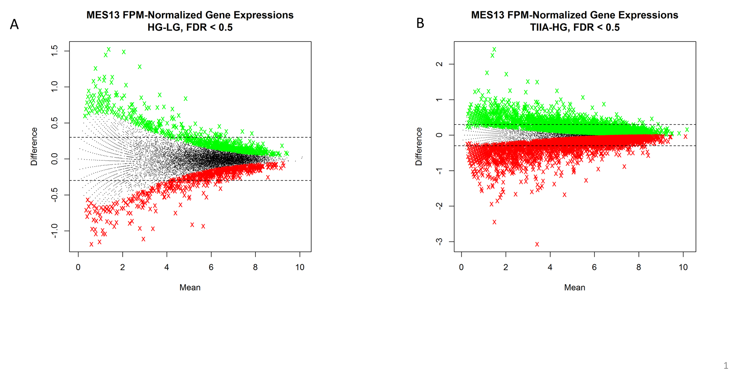
Figure 1. MA plots (log2 means vs. log2 difference) of the gene expressions in the two comparisons, HF vs. LG (A) and TIIA in HG vs. HG only (B). The two horizontal dotted lines correspond to log2 differences of +/-0.3. The green or red symbols corresponds to upregulated or downregulated genes with FDR values of 0.5 or less

Slide 2
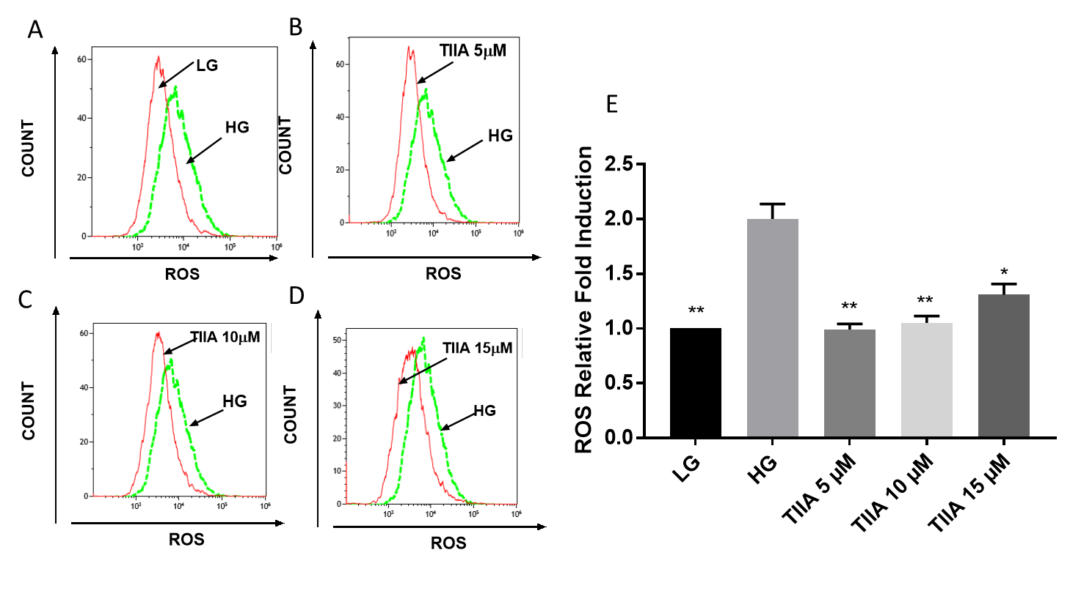
Figure 2. Effects of TIIA on production of intracellular reactive oxygen species (ROS) induced by 2 day treatment of high glucose (HG) In mouse kidney mes-13 cells via flow cytometry. Two days treatment of HG induced increase of intracellular ROS damage comparing with low glucose (LG) group(A), co-treatment of 5µM TIIA (B), 10 µM TIIA (C) and 15 µM TIIA(D) could protect mes-13 cells against ROS damage from HG. Relative ROS fold change normalized by LG (E) are expressed as means ± Std for 3 independent replicates and significant (p<0.05, *; p<0.01, **) difference comparing with HG are indicated.

Slide 3
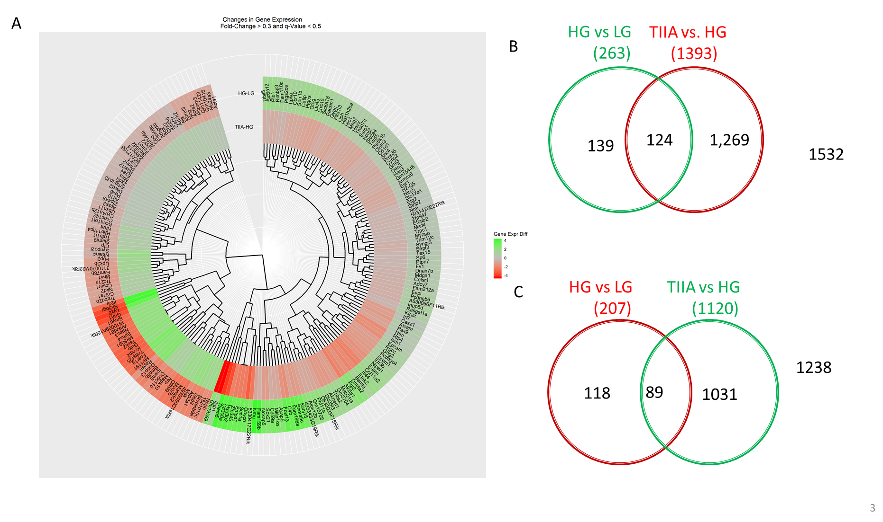
Figure 3 Overview of the differentially expressed genes in 2 comparisons among 3 groups (HG/LG and TIIA/HG). (A) Doughnut Heat map of 213 overlapped Genes with differential expression that appeared in HG versus LG group and TIIA versus HG group. (B, C) Venn diagrams comparing the up-regulated (green) and down-regulated genes (red) between HG versus LG group and TIIA versus HG group. Genes with log₂ fold changes greater than 0.3 were counted.

Slide 4
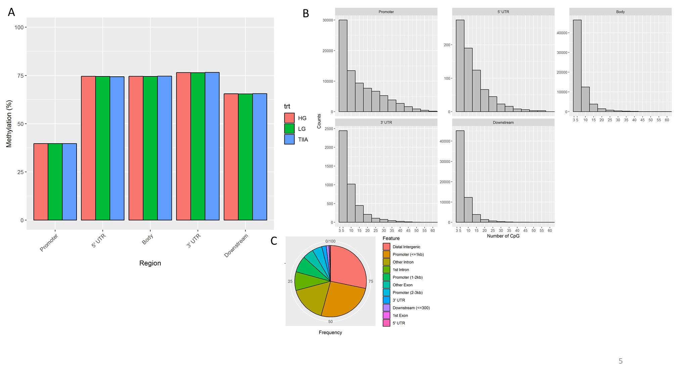
Figure 4. Sureselect Methyl-seq results (A) Percent of Methylated CpG by region and treatment;
(B) Distribution of DMR by Number of CpG and Region; (C) DMR annotation by region (%)

Slide 5
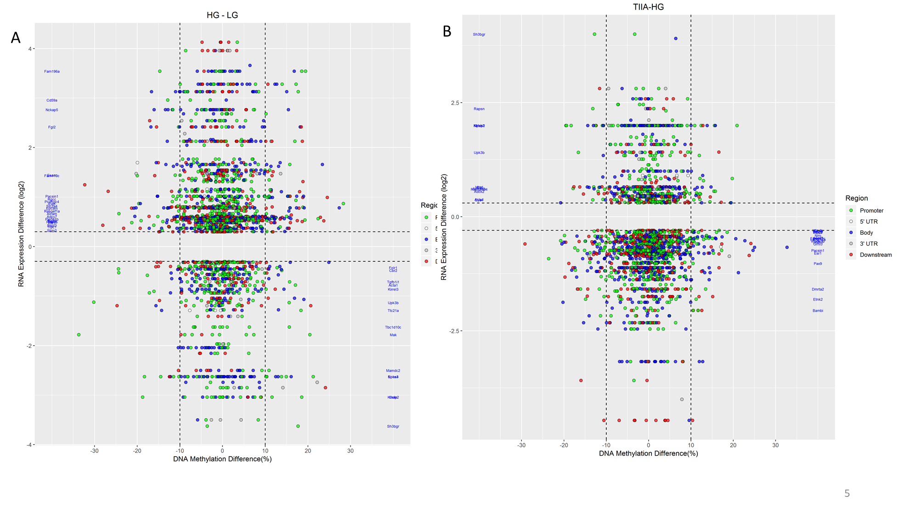
Figure 5 Quadrantal graph shows correlation between RNA-seq and methyl-seq. The upper left and lower right quadrantal region of indicate those genes with reversed change of methylation and RNA expression in HG/LG (A) and TIIA/HG(B) comparisons

Slide 6
Figure 6. RNA qPCR validation for the genes of interest. The gene expressions from HG group were normalized to 1 and the relative fold changes were obtained from the comparation between the other 2 groups to HG group. All the data are presented are expressed as means ± Std for 3 independent replicates and significant (*, p<0.05) difference comparing with HG are indicated

Slide 7
A
B
Figure 7. In-depth analysis of DNA methylation of Bmp8b(A), Fgl2(B), Gulo(C) and Kcnip(D) in looipops figures
C
D

Slide 8
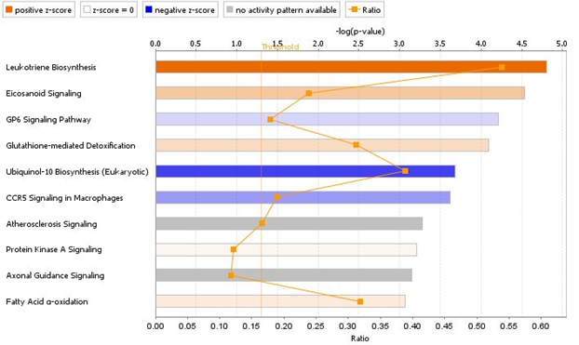
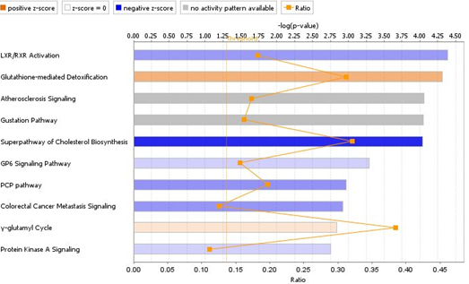
A
B
Figure 8 Canonical pathways identified by IPA for all significant and reliable Differentially expressed genes in HG versus LG (A) and TIIA versus HG (B) from mes-13 cells after 5 days treatment. Canonical
pathways are displayed as the –log(p-value) (upper) with the threshold of 1.5 indicating the minimum significance level. Length of the bars represents the significant associations. The ratio indicates the number of Differentially expressed genes in the comparison that map to a given canonical pathway divided by the total number of genes in that pathway.

Slide 9
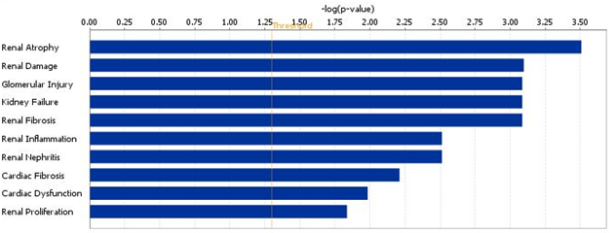
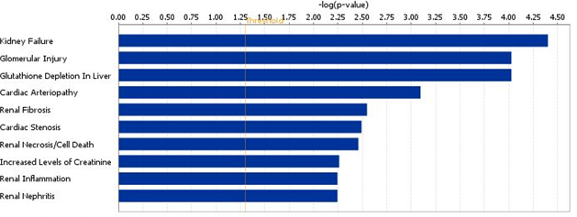
Figure 9. The 10 most associated tox results related to HG versus LG (upper panel) and TIIA versus HG(lower panel)

Slide 10
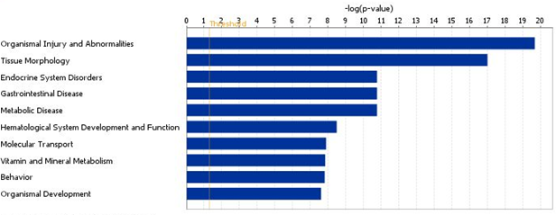
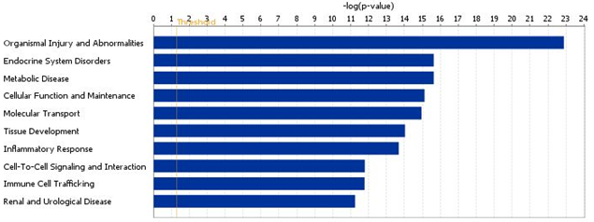
Figure 10. The 10 most associated disease related to HG versus LG (upper panel) and TIIA versus HG(lower panel)

